Slide 1
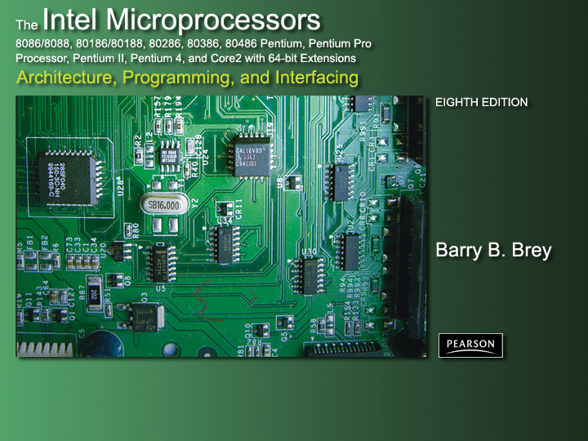
Chapter 1: Introduction to the
Microprocessor and Computer

Slide 2
Introduction
Overview of Intel microprocessors.
Discussion of history of computers.
Function of the microprocessor.
Terms and jargon (computerese).

Slide 3
Chapter Objectives
Upon completion of this chapter, you will be able to:
Converse by using appropriate computer terminology such as bit, byte, data, real memory system, protected mode memory system, Windows, DOS, I/O.
Detail history of the computer and list applications performed by computer systems.
Provide an overview of the various 80X86 and Pentium family members.

Slide 4
Chapter Objectives
(cont.)
Upon completion of this chapter, you will be able to:
Draw the block diagram of a computer system and explain the purpose of each block.
Describe the function of the microprocessor and detail its basic operation.
Define the contents of the memory system in the personal computer.

Slide 5
Chapter Objectives
(cont.)
Upon completion of this chapter, you will be able to:
Convert between binary, decimal, and hexadecimal numbers.
Differentiate and represent numeric and alphabetic information as integers, floating-point, BCD, and ASCII data.

Slide 6
1–1 A HISTORICAL BACKGROUND
Events leading to development of
the microprocessor.
80X86, Pentium, Pentium Pro, Pentium III, Pentium 4, and Core2 microprocessors.
While not essential to understand the microprocessor, furnishes:
  interesting reading
  historical perspective of fast-paced evolution

Slide 7
The Mechanical Age
Idea of computing system not new.
Calculating with a machine dates to 500 BC.
Babylonians invented the abacus.
  first mechanical calculator
  strings of beads perform calculations
Used by ancient priests to keep track of storehouses of grain.
  still in use today

Slide 8
In 1642 mathematician Blaise Pascal invented a calculator constructed of gears and wheels.
  each gear contained 10 teeth
When moved one complete revolution, a second gear advances one place.
  same principle used in automobile odometer
Basis of all mechanical calculators.
PASCAL programming language is named in honor of Blaise Pascal.

Slide 9
First practical geared mechanical machines
to compute information date to early 1800s.
  humans dreamed of mechanical machines that could compute with a program
One early pioneer of mechanical computing machinery was Charles Babbage.
  aided by Ada Byron, Countess of Lovelace
Commissioned in 1823 by Royal Astronomical Society to build programmable calculating machine.
  to generate Royal Navy navigational tables

Slide 10
He began to create his Analytical Engine.
Steam-powered mechanical computer.
  stored a thousand 20-digit decimal numbers
Variable program could modify function of the machine to perform various calculating tasks.
  input through punched cards, much as computers in the 1950s and 1960s used punched cards
It is assumed idea of punched cards is from Joseph Jacquard, a Frenchman.
  used punched cards as input to a weaving machine he invented in 1801

Slide 11
Jacquard’s loom used punched cards to select intricate weaving patterns in cloth it produced.
  punched cards programmed the loom
After many years of work Babbage’s dream began to fade.
  machinists of his day unable to create the parts needed to complete his work
Analytical Engine required more than 50,000 machined parts.
  they could not be made with enough precision to allow his engine to function reliably

Slide 12
The Electrical Age
1800s saw advent of the electric motor.
  conceived by Michael Faraday
Also a multitude of electrically motor-driven adding machines based on the Pascal mechanical calculator.
  common office equipment until 1970s
Introduced by Bomar Corporation the Bomar Brain, was a handheld electronic calculator.
  first appeared in early 1970s

Slide 13
Monroe also pioneer of electronic calculators, making desktop models.
  four-function; size of cash registers
In 1889, Herman Hollerith developed the punched card for storing data.
  apparently also borrowed Jacquard ideas
Also developed mechanical machine that counted, sorted, and collated information stored on punched cards.
  driven by one of the new electric motors

Slide 14
Calculating by machine intrigued US govt.
  Hollerith commissioned to use system to store and tabulate 1890 census information
In 1896 Hollerith formed Tabulating Machine Company.
  developed line of machines using punched cards for tabulation
After a number of mergers, Tabulating Machine Co. was formed into International Business Machines Corporation.
  referred to more commonly as IBM, Inc.

Slide 15
Punched cards used in early computer systems often called Hollerith cards.
  in honor of Herman Hollerith
12-bit code used on a punched card is called the Hollerith code.

Slide 16
Mechanical-electric machines dominated information processing world until 1941.
  construction of first electronic calculating machine
German inventor Konrad Zuse, invented the first modern electromechanical computer.
His Z3 calculating computer probably invented for aircraft and missile design.
  during World War II for the German war effort
Z3 a relay logic machine clocked at 5.33 Hz.
  far slower than latest multiple GHz microprocessors

Slide 17
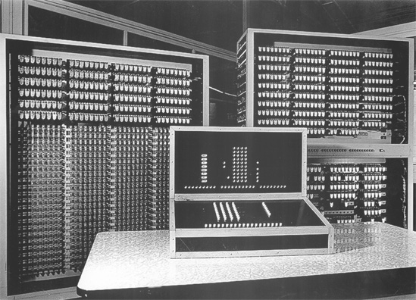
Figure 1–1 The Z3 computer developed by Konrad Zuse uses a 5.33 hertz clocking frequency. (Photo courtesy of Horst Zuse, the son of Konrad.)

Slide 18
Had Zuse been given adequate funding,
likely would have developed a much more powerful computer system.
In 1936 Zuse constructed a mechanical version of his system.
In 1939 constructed first electromechanical computer system, called the Z2.
  Zuse today receiving belated honors for
  pioneering work in the area of digital electronics

Slide 19
First electronic computer placed in operation to break secret German military codes.
recently discovered through declassification of military documents of 1943.
System invented by Alan Turing.
  used vacuum tubes,
Turing called his machine Colossus.
  probably because of its size

Slide 20
Although design allowed it to break secret German military codes generated by the mechanical Enigma machine, it could not solve other problems.
Colossus not programmable
A fixed-program computer system
  today often called a special-purpose computer
First general-purpose, programmable electronic computer system developed 1946.
  at University of Pennsylvania

Slide 21
Electronic Numerical Integrator and Calculator (ENIAC), a huge machine.
  over 17,000 vacuum tubes; 500 miles of wires
  weighed over 30 tons
  about 100,000 operations per second
Programmed by rewiring its circuits.
  process took many workers several days
  workers changed electrical connections on plug-boards like early telephone switchboards
Required frequent maintenance.
  vacuum tube service life a problem

Slide 22
December 23, 1947, John Bardeen, William Shockley, and Walter Brattain develop the transistor at Bell Labs.
Followed by 1958 invention of the integrated circuit (IC) by Jack Kilby of Texas Instruments.
IC led to development of digital integrated circuits in the 1960s.
  RTL, or resistor-to-transistor logic
First microprocessor developed at Intel Corporation in 1971.

Slide 23
Intel engineers Federico Faggin, Ted Hoff, and Stan Mazor developed the 4004 microprocessor.
U.S. Patent 3,821,715.
Device started the microprocessor revolution continued today at an ever-accelerating pace.

Slide 24
Programming Advancements
Once programmable machines developed, programs and programming languages began to appear.
As early practice of rewiring circuits proved too cumbersome, computer languages began to appear in order to control the computer.
The first, machine language, was constructed of ones and zeros using binary codes.
  stored in the computer memory system as groups of instructions called a program

Slide 25
More efficient than rewiring a machine to program it.
  still time-consuming to develop a program due
  to sheer number of program codes required
Mathematician John von Neumann first modern person to develop a system to accept instructions and store them in memory.
Computers are often called von Neumann machines in his honor.
  recall that Babbage also had developed the concept long before von Neumann

Slide 26
Once systems such as UNIVAC became available in early 1950s, assembly language was used to simplify entering binary code.
Assembler allows programmer to use mnemonic codes…
  such as ADD for addition
In place of a binary number.
  such as 0100 0111
Assembly language an aid to programming.

Slide 27
1957 Grace Hopper developed first high-level programming language called FLOWMATIC.
  computers became easier to program
In same year, IBM developed FORTRAN
FORmula TRANslator) for its systems.
  Allowed programmers to develop programs that used formulas to solve mathematical problems.
FORTRAN is still used by some scientists for computer programming.
  Similar language, ALGOL (ALGOrithmic Language) introduced about a year later

Slide 28
First successful, widespread programming language for business applications was COBOL (COmputer Business Oriented Language).
COBOL usage diminished in recent years.
  still a player in some large business and government systems
Another once-popular business language is RPG (Report Program Generator).
  allows programming by specifying form of the input, output, and calculations

Slide 29
Since early days of programming, additional languages have appeared.
Some common modern programming languages are BASIC, C#, C/C++, Java, PASCAL, and ADA.
  BASIC and PASCAL languages both designed as teaching languages, but escaped the classroom.
BASIC used in many computer systems.
  among most common languages today
  probably easiest of all to learn

Slide 30
Estimates indicate BASIC used for 80% of programs written by personal computer users.
Visual BASIC, has made programming in the Windows environment easier.
  could supplant C/C++ and PASCAL
  as a scientific language, but is doubtful
C# language is gaining headway.
  may actually replace C/C++ and most other languages including Java
  may eventually replace BASIC
Which becomes dominant remains in future.

Slide 31
Scientific community uses primarily C/C++.
  occasionally PASCAL and FORTRAN
Recent survey of embedded system developers showed C was used by 60%.
  30% used assembly language
  remainder used BASIC and JAVA
These languages allow programmer almost complete control over the programming environment and computer system.
  especially C/C++

Slide 32
C/C++ replacing some low-level machine control software or drivers normally reserved for assembly language.
Assembly language still plays important role.
  many video games written almost exclusively
  in assembly language
Assembly also interspersed with C/C++ to perform machine control functions efficiently.
  some newer parallel instructions found on Pentium and Core2 microprocessors only programmable in assembly language

Slide 33
ADA used heavily by Department of Defense.
The ADA language was named in honor of Augusta Ada Byron, Countess of Lovelace.
The Countess worked with Charles Babbage in the early 1800s.
  development of software for Analytical Engine

Slide 34
The Microprocessor Age
World’s first microprocessor the Intel 4004.
A 4-bit microprocessor-programmable controller on a chip.
Addressed 4096, 4-bit-wide memory locations.
  a bit is a binary digit with a value of one or zero
  4-bit-wide memory location often called a nibble
The 4004 instruction set contained 45 instructions.

Slide 35
Fabricated with then-current state-of-the-art P-channel MOSFET technology.
Executed instructions at 50 KIPs (kilo-instructions per second).
  slow compared to 100,000 instructions per second by 30-ton ENIAC computer in 1946
Difference was that 4004 weighed less than an ounce.
4-bit microprocessor debuted in early game systems and small control systems.
  early shuffleboard game produced by Bailey

Slide 36
Main problems with early microprocessor were speed, word width, and memory size.
Evolution of 4-bit microprocessor ended when Intel released the 4040, an updated 4004.
  operated at a higher speed; lacked improvements in word width and memory size
Texas Instruments and others also produced 4-bit microprocessors.
  still survives in low-end applications such as microwave ovens and small control systems
  Calculators still based on 4-bit BCD (binary-coded decimal) codes

Slide 37
With the microprocessor a commercially viable product, Intel released 8008 in 1971.
  extended 8-bit version of 4004 microprocessor
Addressed expanded memory of 16K bytes.
  A byte is generally an 8-bit-wide binary number and a K is 1024.
  memory size often specified in K bytes
Contained additional instructions, 48 total.
Provided opportunity for application in more advanced systems.
  engineers developed demanding uses for 8008

Slide 38
Somewhat small memory size, slow speed, and instruction set limited 8008 usefulness.
Intel introduced 8080 microprocessor in 1973.
  first of the modem 8-bit microprocessors
Motorola Corporation introduced MC6800 microprocessor about six months later.
8080—and, to a lesser degree, the MC6800—ushered in the age of the microprocessor.
  other companies soon introduced their own versions of the 8-bit microprocessor

Slide 39
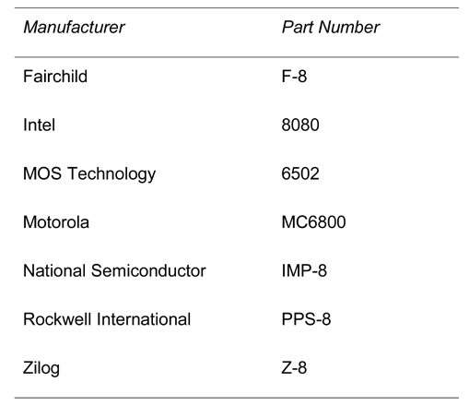
Table 1–1 Early 8-bit microprocessors

Slide 40
Only Intel and Motorola continue to create new, improved microprocessors.
  IBM also produces Motorola-style microprocessors
Motorola sold its microprocessor division.
  now called Freescale Semiconductors, Inc.
Zilog still manufactures microprocessors.
  microcontrollers and embedded controllers instead of general-purpose microprocessors

Slide 41
What Was Special about the 8080?
8080 addressed four times more memory.
  64K bytes vs l6K bytes for 8008
Executed additional instructions; 10x faster.
  addition taking 20 µs on an 8008-based system required only 2.0 µs on an 8080-based system
TTL (transistor-transistor logic) compatible.
  the 8008 was not directly compatible
Interfacing made easier and less expensive.

Slide 42
The MITS Altair 8800, was released in 1974.
  number 8800 probably chosen to avoid copyright violations with Intel
BASIC language interpreter for the Altair 8800 computer developed in 1975.
  Bill Gates and Paul Allen, founders of Microsoft Corporation
The assembler program for the Altair 8800 was written by Digital Research Corporation.
  once produced DR-DOS for the personal computer

Slide 43
The 8085 Microprocessor
In 1977 Intel Corporation introduced an updated version of the 8080—the 8085.
Last 8-bit, general-purpose microprocessor developed by Intel.
Slightly more advanced than 8080; executed software at an even higher speed.
  769,230 instructions per second vs 500,000 per second on the 8080).

Slide 44
Main advantages of 8085 were its internal clock generator and system controller, and higher clock frequency.
  higher level of component integration reduced
  the 8085’s cost and increased its usefulness
Intel has sold over 100 million of the 8085.
  its most successful 8-bit, general-purpose microprocessor.
  also manufactured by many other companies, meaning over 200 million in existence
Applications that contain the 8085 will likely continue to be popular.

Slide 45
Zilog Corporation sold 500 million of their
8-bit Z80microprocessors.
The Z-80 is machine language–compatible with the 8085.
Over 700 million microprocessors execute 8085/Z-80 compatible code.

Slide 46
The Modern Microprocessor
In 1978 Intel released the 8086; a year or so later, it released the 8088.
Both devices are 16-bit microprocessors.
  executed instructions in as little as 400 ns (2.5 millions of instructions per second)
  major improvement over execution speed of 8085
8086 & 8088 addressed 1M byte of memory.
  16 times more memory than the 8085
  1M-byte memory contains 1024K byte-sized memory locations or 1,048,576 bytes

Slide 47
Higher speed and larger memory size allowed 8086 & 8088 to replace smaller minicomputers in many applications.
Another feature was a 4- or 6-byte instruction cache or queue that prefetched instructions before they were executed.
  queue sped operation of many sequences of instruction
  basis for the much larger instruction caches
  found in modem microprocessors.

Slide 48
Increased memory size and additional instructions in 8086/8088 led to many sophisticated applications.
Improvements to the instruction set included multiply and divide instructions.
  missing on earlier microprocessors
Number of instructions increased.
  from 45 on the 4004, to 246 on the 8085
  over 20,000 variations on the 8086 & 8088

Slide 49
These microprocessors are called CISC (complex instruction set computers).
  additional instructions eased task of developing efficient and sophisticated applications
16-bit microprocessor also provided more internal register storage space.
  additional registers allowed software to be
  written more efficiently
  evolved to meet need for larger memory systems

Slide 50
Popularity of Intel ensured in 1981 when IBM chose the 8088 in its personal computer.
Spreadsheets, word processors, spelling checkers, and computer-based thesauruses were memory-intensive .
  required more than 64K bytes of memory found
  in 8-bit microprocessors to execute efficiently
  The 16-bit 8086 and 8088 provided 1M byte of memory for these applications

Slide 51
The 80286 Microprocessor
Even the 1M-byte memory system proved limiting for databases and other applications.
  Intel introduced the 80286 in 1983
  an updated 8086
Almost identical to the 8086/8088.
  addressed 16M-byte memory system instead
  of a 1M-byte system
Instruction set almost identical except for a few additional instructions.
  managed the extra 15M bytes of memory

Slide 52
80286 clock speed increased in 8.0 Mhz version.
  executed some instructions in as little as 250 ns (4.0 MIPs)
Some changes to internal execution of instructions led to eightfold increase in speed for many instructions.

Slide 53
The 32-Bit Microprocessor
Applications demanded faster microprocessor speeds, more memory, and wider data paths.
Led to the 80386 in 1986 by Intel.
  major overhaul of 16-bit 8086–80286 architecture
Intel’s first practical microprocessor to contain a 32-bit data bus and 32-bit memory address.
  Intel produced an earlier, unsuccessful 32-bit microprocessor called iapx-432

Slide 54
Through 32-bit buses, 80386 addressed up
to 4G bytes of memory.
  1G memory = 1024M, or 1,073,741,824 locations
  1,000,000 typewritten, double-spaced pages of ASCII text data
80386SX addressed 16M bytes of memory through a 16-bit data and 24-bit address bus.
80386SL/80386SLC addressed 32M bytes memory via 16-bit data, 25-bit address bus.
80386SLC contained an internal cache to process data at even higher rates.

Slide 55
Intel released 80386EX in 1995.
Called an embedded PC.
  contains all components of the AT class
  computer on a single integrated circuit
24 lines for input/output data.
26-bit address bus; 16-bit data bus.
DRAM refresh controller.
Programmable chip selection logic

Slide 56
Applications needing higher speeds and large memory systems include software systems that use a GUI, or graphical user interface
Modern graphical displays contain 256,000
or more picture elements (pixels, or pels).
VGA (variable graphics array) resolution is 640 pixels per scanning line by 480 lines.
  resolution used to display computer boot screen
To display one screen of information, each picture element must be changed.
  requires a high-speed microprocessor

Slide 57
GUI packages require high microprocessor speeds and accelerated video adapters for quick and efficient manipulation of video text and graphical data.
  the most striking system is Microsoft Windows
GUI often called a WYSIWYG (what you see is what you get) display.

Slide 58
32-bit microprocessor needed due to size of its data bus.
  transfers real (single-precision floating-point) numbers that require 32-bit-wide memory
To process 32-bit real numbers, the microprocessor must efficiently pass them between itself and memory.
  with 8-bit data bus, takes four read or write cycles
  only one read or write cycle is required for 32 bit
Significantly increases speed of any program that manipulates real numbers.

Slide 59
High-level languages, spreadsheets, and database management systems use real numbers for data storage.
  also used in graphical design packages that use vectors to plot images on the video screen
  CAD (computer-aided drafting/design)
  systems as AUTOCAD, ORCAD
80386 had higher clocking speeds and included a memory management unit.
  allowed memory resources to be allocated
  and managed by the operating system

Slide 60
80386 included hardware circuitry for memory management and assignment.
  improved efficiency, reduced software overhead
  earlier microprocessors left memory
  management completely to the software
Instruction set, memory management upward-compatible with 8086, 8088, and 80286.
  additional instructions referenced 32-bit registers and managed the memory system
Features allowed older, 16-bit software to operate on the 80386 microprocessor.

Slide 61
The 80486 Microprocessor
In 1989 Intel released the 8048.
Highly integrated package.
80386-like microprocessor.
80387-like numeric coprocessor.
8K-byte cache memory system.

Slide 62
Internal structure of 80486 modified so about half of its instructions executed in one clock instead of two clocks.
  in a 50 MHz version, about half of instructions executed in 25 ns (50 MIPs)
  50% over 80386 operated at same clock speed
Double-clocked 80486DX2 executed instructions at 66 MHz, with memory transfers at 33 MHz.
  called a double-clocked microprocessor

Slide 63
A triple-clocked version improved speed to 100 MHz with memory transfers at 33 MHz.
  about the same speed as 60 MHz Pentium.
Expanded 16K-byte cache.
  in place of standard 8K-byte cache
Advanced Micro Devices (AMD) produced a triple-clocked version with a bus speed of 40 MHz and a clock speed of 120 MHz.
The future promises rates 10 GHz or higher.

Slide 64
Other versions called OverDrive processors.
  a double-clocked 80486DX that replaced an 80486SX or slower-speed 80486DX
  functioned as a doubled-clocked version of the microprocessor

Slide 65
The Pentium Microprocessor
Introduced 1993, Pentium was similar to 80386 and 80486 microprocessors.
Originally labeled the P5 or 80586.
  Intel decided not to use a number because it appeared to be impossible to copyright a number
Introductory versions operated with a clocking frequency of 60 MHz & 66 MHz, and a speed of 110 MIPs.

Slide 66
Double-clocked Pentium at 120 MHz and 133 MHz, also available.
  fastest version produced 233 MHz Pentium
  a three and one-half clocked version
Cache size was increased to 16K bytes from the 8K cache found in 80486.
8K-byte instruction cache and data cache.
Memory system up to 4G bytes.
Data bus width increased to a full 64 bits.
Data bus transfer speed 60 MHz or 66 MHz.
  depending on the version of the Pentium

Slide 67
Wider data bus width accommodated double-precision floating-point numbers used in high-speed, vector-generated graphical displays.
  should allow virtual reality software and video to operate at more realistic rates
Widened data bus and higher speed allow full-frame video displays at scan rates of 30 Hz or higher.
  comparable to commercial television

Slide 68
Recent Pentium versions also included additional instructions.
  multimedia extensions, or MMX instructions
Intel hoped MMX would be widely used
  few software companies have used
  no high-level language support for instructions
OverDrive (P24T) for older 80486 systems.
63 MHz version upgrades 80486DX2 50 MHz systems; 83 MHz upgrades 66 MHz systems.
  system performs somewhere between a 66 MHz Pentium and a 75 MHz Pentium

Slide 69
Pentium OverDrive represents ideal upgrade path from the 80486 to the Pentium.
  executes two instructions not dependent on each other, simultaneously per clocking period
  dual integer processors most ingenious feature
  contains two independent internal integer processors called superscaler technology
Jump prediction speeds execution of program loops; internal floating-point coprocessor handles floating-point data.
These portend continued success for Intel.

Slide 70
Intel may allow Pentium to replace some
RISC (reduced instruction set computer) machines.
Some newer RISC processors execute more than one instruction per clock.
  through superscaler technology
Motorola, Apple, and IBM produce PowerPC, a RISC with two integer units and a floating-point unit.
  boosts Macintosh performance, but slow to efficiently emulate Intel microprocessors

Slide 71
Currently 6 million Apple Macintosh systems
260 million personal computers based on Intel microprocessors.
1998 reports showed 96% of all PCs shipped with the Windows operating system.
Apple computer replaced PowerPC with the Intel Pentium in most of its computer systems.
  appears that PowerPC could not keep pace with the Pentium line from Intel

Slide 72
To compare speeds of microprocessors, Intel devised the iCOMP- rating index.
  composite of SPEC92, ZD Bench, Power Meter
The iCOMP1 rating index is used to rate the speed of all Intel microprocessors through the Pentium.
Figure 1–2 shows relative speeds of the 80386DX 25 MHz version through the Pentium 233 MHz version.

Slide 73
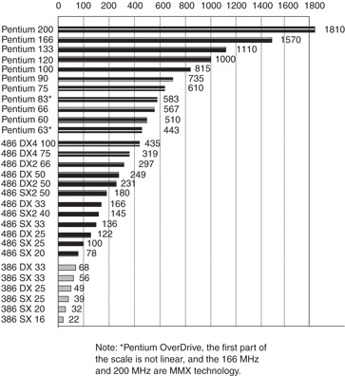
Figure 1–2 The Intel iCOMP-rating index.

Slide 74
Since release of Pentium Pro and Pentium II, Intel has switched to the iCOMP2- rating.
  scaled by a factor of 10 from the iCOMP1 index
Figure 1–3 shows iCOMP2 index listing the Pentium III at speeds up to 1000 MHz.
Figure 1–4 shows SYSmark 2002 for the Pentium III and Pentium 4.
Intel has not released benchmarks that compare versions of the microprocessor since the SYSmark 2002.
  newer available do not compare versions

Slide 75
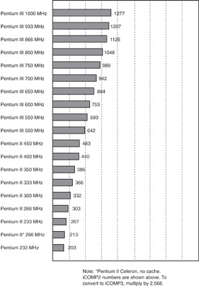
Figure 1–3 The Intel iCOMP2-rating index.

Slide 76
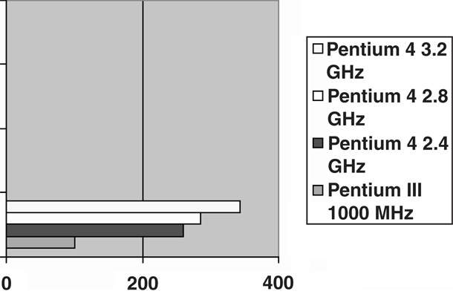
Figure 1–4 Intel microprocessor performance using SYSmark 2002.

Slide 77
Pentium Pro Processor
A recent entry, formerly named the P6.
21 million transistors, integer units, floating-point unit, clock frequency 150 and 166 MHz
Internal 16K level-one (L1) cache.
  8K data, 8K for instructions
  Pentium Pro contains 256K level-two (L2) cache
Pentium Pro uses three execution engines, to execute up to three instructions at a time.
  can conflict and still execute in parallel

Slide 78
Pentium Pro optimized to efficiently execute 32-bit code.
  often bundled with Windows NT rather than normal versions of Windows 95
  Intel launched Pentium Pro for server market
Pentium Pro can address 4G-byte or a 64G-byte memory system.
  36-bit address bus if configured for a 64G memory system

Slide 79
Pentium II and Pentium Xeon Microprocessors
Pentium II, released 1997, represents new direction for Intel.
Intel has placed Pentium II on a small circuit board, instead of being an integrated circuit.
  L2 cache on main circuit board of not fast
  enough to function properly with Pentium II
Microprocessor on the Pentium II module actually Pentium Pro with MMX extensions.

Slide 80
In 1998 Intel changed Pentium II bus speed.
  newer Pentium II uses a 100 MHz bus speed
Higher speed memory bus requires 8 ns SDRAM.
  replaces 10 ns SDRAM with 66 MHz bus speed

Slide 81
Intel announced Xeon in mid-1998.
  specifically designed for high-end workstation
  and server applications
Xeon available with 32K L1 cache and L2 cache size of 512K, 1M, or 2M bytes.
Xeon functions with the 440GX chip set.
Also designed to function with four Xeons in the same system, similar to Pentium Pro.
Newer product represents strategy change.
  Intel produces a professional and home/business version of the Pentium II

Slide 82
Pentium III Microprocessor
Faster core than Pentium II; still a P6 or Pentium Pro processor.
Available in slot 1 version mounted on a plastic cartridge.
Also socket 370 version called a flip-chip which looks like older Pentium package.
Pentium III available with clock frequencies
up to 1 GHz.

Slide 83
Slot 1 version contains a 512K cache; flip-chip version contains 256K cache.
Flip-chip version runs at clock speed; Slot 1 cache version runs at one-half clock speed.
Both versions use 100 Mhz memory bus.
  Celeron memory bus clock speed 66 MHz
Front side bus connection, microprocessor to memory controller, PCI controller, and AGP controller, now either 100 or 133 MHz.
  this change has improved performance
  memory still runs at 100 MHz

Slide 84
Pentium 4 and Core2 Microprocessors
Pentium 4 first made available in late 2000.
  most recent version of Pentium called Core2
  uses Intel P6 architecture
Pentium 4 available to 3.2 GHz and faster.
  supporting chip sets use RAMBUS or DDR memory in place of SDRAM technology
Core2 is available at speeds of up to 3 GHz.
  improvement in internal integration, at present
  the 0.045 micron or 45 nm technology

Slide 85
A likely change is a shift from aluminum to copper interconnections inside the microprocessor.
Copper is a better conductor.
  should allow increased clock frequencies
  especially true now that a method for using copper has surfaced at IBM
Another event to look for is a change in the speed of the front side bus.
  increase beyond current maximum 1033 MHz

Slide 86
Pentium 4 and Core2, 64-bit and Multiple Core Microprocessors
Recent modifications to Pentium 4 and Core2 include a 64-bit core and multiple cores.
64-bit modification allows address of over 4G bytes of memory through a 64-bit address.
  40 address pins in these newer versions allow
  up to 1T (terabytes) of memory to be accessed
Also allows 64-bit integer arithmetic.
  less important than ability to address more memory

Slide 87
Biggest advancement is inclusion of multiple cores.
  each core executes a separate task in a program
Increases speed of execution if program is written to take advantage of multiple cores.
  called multithreaded applications
Intel manufactures dual and quad core versions; number of cores will likely increase to eight or even sixteen.

Slide 88
Multiple cores are current solution to providing faster microprocessors.
Intel recently demonstrated Core2 containing 80 cores, using 45 nm fabrication technology.
Intel expects to release an 80-core version some time in the next 5 years.
Fabrication technology will become slightly smaller with 35 nm and possibly 25 nm technology.

Slide 89
The Future of Microprocessors
No one can make accurate predictions.
Success of Intel should continue.
Change to RISC technology may occur; more likely improvements to new hyper-threading technology.
  joint effort by Intel and Hewlett-Packard
New technology embodies CISC instruction set of 80X86 family.
  software for the system will survive

Slide 90
Basic premise is many microprocessors communicate directly with each other.
  allows parallel processing without any change
  to the instruction set or program
Current superscaler technology uses many microprocessors; all share same register set.
  new technology contains many microprocessors
  each contains its own register set linked with the other microprocessors’ registers
Offers true parallel processing without writing any special program.

Slide 91
In 2002, Intel released a new architecture 64 bits in width with a 128-bit data bus.
Named Itanium; joint venture called EPIC (Explicitly Parallel Instruction Computing) of Intel and Hewlett-Packard.
The Itanium architecture allows greater parallelism than traditional architectures.
128 general-purpose integer and 128 floating-point registers; 64 predicate registers.
Many execution units to ensure enough hardware resources for software.

Slide 92
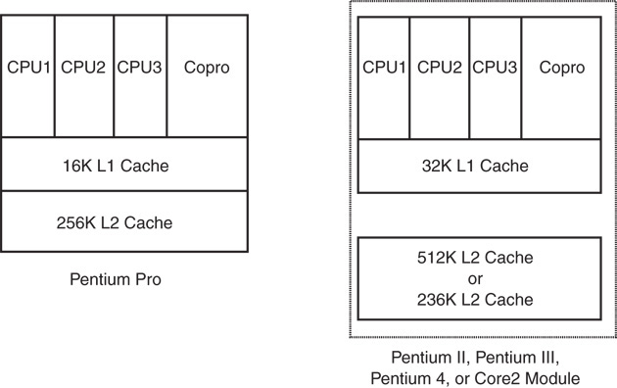
Figure 1–5a Conceptual views of the 80486, Pentium Pro, Pentium II, Pentium III, Pentium 4, and Core2 microprocessors.

Slide 93
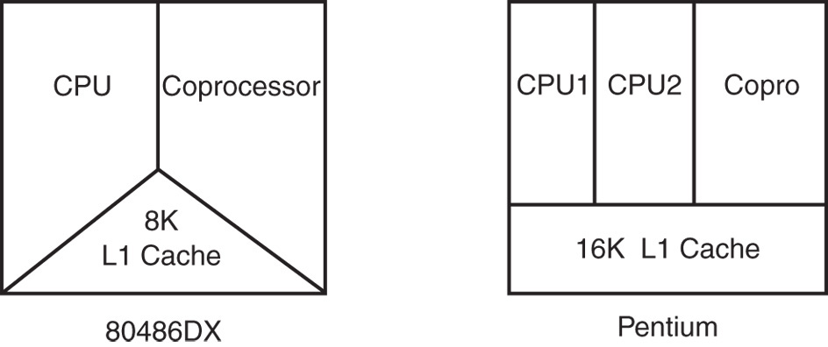
Figure 1–5b Conceptual views of the 80486, Pentium Pro, Pentium II, Pentium III, Pentium 4, and Core2 microprocessors.

Slide 94
Clock frequencies seemed to have peaked.
Surge to multiple cores has begun.
Memory speed a consideration.
  speed of dynamic RAM memory has not
  changed for many years.
Push to static RAM memory will eventually. increase the performance of the PC.
  main problem with large static RAM is heat
  static RAM operates 50 times faster than dynamic RAM

Slide 95
Speed of mass storage another problem.
  transfer speed of hard disk drives has changed little in past few years
  new technology needed for mass storage
Flash memory could be solution.
  write speed comparable to hard disk memory
Flash memory could store the operation system for common applications.
  would allow operating system to load in a second or two instead of many seconds now required

Slide 96
1–2 THE MICROPROCESSOR-BASED PERSONAL COMPUTER SYSTEM
Computers have undergone many changes recently.
Machines that once filled large areas reduced to small desktop computer systems because
of the microprocessor.
  although compact, they possess computing power only dreamed of a few years ago

Slide 97
Figure 1–6 shows block diagram of the personal computer.
Applies to any computer system, from early mainframe computers to the latest systems.
Diagram composed of three blocks interconnected by buses.
  a bus is the set of common connections
  that carry the same type of information

Slide 98
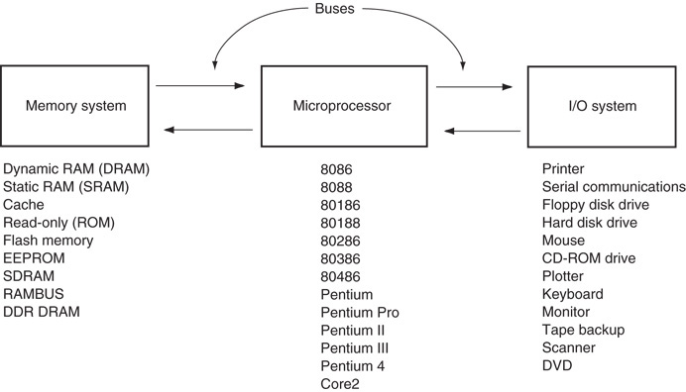
Figure 1–6 The block diagram of a microprocessor-based computer system.

Slide 99
The Memory and I/O System
Memory structure of all Intel-based personal computers similar.
Figure 1–7 illustrates memory map of a personal computer system.
This map applies to any IBM personal computer.
  also any IBM-compatible clones in existence

Slide 100
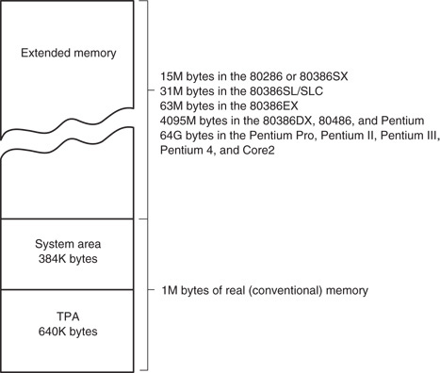
Figure 1–7 The memory map of a personal computer.

Slide 101
Main memory system divided into three parts:
  TPA (transient program area)
  system area
  XMS (extended memory system)
Type of microprocessor present determines whether an extended memory system exists.
First 1M byte of memory often called the real or conventional memory system.
  Intel microprocessors designed to function
  in this area using real mode operation

Slide 102
80286 through the Core2 contain the TPA (640K bytes) and system area (384K bytes).
  also contain extended memory
  often called AT class machines
The PS/l and PS/2 by IBM are other versions of the same basic memory design.
Also referred to as ISA (industry standard architecture) or EISA (extended ISA).
The PS/2 referred to as a micro-channel architecture or ISA system.
  depending on the model number

Slide 103
Pentium and ATX class machines feature addition of the PCI (peripheral component interconnect) bus.
  now used in all Pentium through Core2 systems
Extended memory up to 15M bytes in the 80286 and 80386SX; 4095M bytes in 80486 80386DX, Pentium microprocessors.
The Pentium Pro through Core2 computer systems have up to 1M less than 4G or 1 M less than 64G of extended memory.
Servers tend to use the larger memory map.

Slide 104
Many 80486 systems use VESA local, VL bus to interface disk and video to the microprocessor at the local bus level.
  allows 32-bit interfaces to function at same clocking speed as the microprocessor
  recent modification supporting 64-bit data bus
  has generated little interest
ISA/EISA standards function at 8 MHz.
PCI bus is a 32- or 64-bit bus.
  specifically designed to function with the Pentium through Core2 at a bus speed of 33 MHz.

Slide 105
Three newer buses have appeared.
USB (universal serial bus).
  intended to connect peripheral devices to the microprocessor through a serial data path and
  a twisted pair of wires
Data transfer rates are 10 Mbps for USB1.
Increase to 480 Mbps in USB2.

Slide 106
AGP (advanced graphics port) for video cards.
The port transfers data between video card and microprocessor at higher speeds.
  66 MHz, with 64-bit data path
Latest AGP speed 8X or 2G bytes/second.
  video subsystem change made to accommodate new DVD players for the PC.

Slide 107
Latest new buses are serial ATA interface (SATA) for hard disk drives; PCI Express bus for the video card.
The SATA bus transfers data from PC to hard disk at rates of 150M bytes per second; 300M bytes for SATA-2.
  serial ATA standard will eventually reach speeds of 450M bytes per second
PCI Express bus video cards operate at 16X speeds today.

Slide 108
The TPA
The transient program area (TPA) holds the DOS (disk operating system) operating system; other programs that control the computer system.
  the TPA is a DOS concept and not really applicable in Windows
  also stores any currently active or inactive DOS application programs
  length of the TPA is 640K bytes

Slide 109
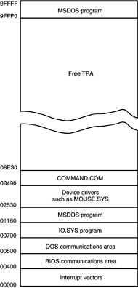
Figure 1–8 The memory map of the TPA in a personal computer. (Note that this map will vary between systems.)
DOS memory map shows how areas of TPA are used for system programs, data
and drivers.
  also shows a large area of memory available for application programs
  hexadecimal number to left of each area represents the memory addresses that begin and end each data area

Slide 110
Hexadecimal memory addresses number each byte of the memory system.
  a hexadecimal number is a number represented in radix 16 or base 16
  each digit represents a value from 0 to 9 and
  from A to F
Often a hexadecimal number ends with an
H to indicate it is a hexadecimal value.
  1234H is 1234 hexadecimal
  also represent hexadecimal data as 0xl234 for
  a 1234 hexadecimal

Slide 111
Interrupt vectors access DOS, BIOS (basic I/O system), and applications.
Areas contain transient data to access I/O devices and internal features of the system.
  these are stored in the TPA so they can be changed as DOS operates

Slide 112
The IO.SYS loads into the TPA from the disk whenever an MSDOS system is started.
IO.SYS contains programs that allow DOS to use keyboard, video display, printer, and other I/O devices often found in computers.
The IO.SYS program links DOS to the programs stored on the system BIOS ROM.

Slide 113
Drivers are programs that control installable I/O devices.
  mouse, disk cache, hand scanner, CD-ROM memory (Compact Disk Read-Only Memory), DVD (Digital Versatile Disk), or installable devices, as well as programs
Installable drivers control or drive devices or programs added to the computer system.
DOS drivers normally have an extension of .SYS; MOUSE.SYS.
DOS version 3.2 and later files have an extension of .EXE; EMM386.EXE.

Slide 114
Though not used by Windows, still used to execute DOS applications, even with Win XP.
Windows uses a file called SYSTEM.INI to load drivers used by Windows.
Newer versions of Windows have a registry added to contain information about the system and the drivers used.
You can view the registry with the REGEDIT program.

Slide 115
COMMAND.COM (command processor) controls operation of the computer from the keyboard when operated in the DOS mode.
COMMAND.COM processes DOS commands as they are typed from the keyboard.
If COMMAND.COM is erased, the computer cannot be used from the keyboard in DOS mode.
  never erase COMMAND.COM, IO.SYS, or MSDOS.SYS to make room for other software
  your computer will not function

Slide 116
The System Area
Smaller than the TPA; just as important.
The system area contains programs on read-only (ROM) or flash memory, and areas of read/write (RAM) memory for data storage.
Figure 1–9 shows the system area of a typical personal computer system.
As with the map of the TPA, this map also includes the hexadecimal memory addresses of the various areas.

Slide 117
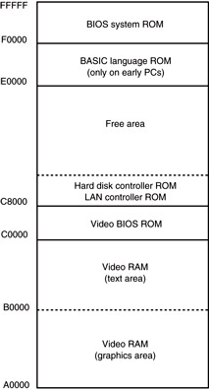
Figure 1–9 The system area of a typical personal computer.
First area of system space contains video display RAM and video control programs on ROM or flash memory.
  area starts at location A0000H and extends to C7FFFH
  size/amount of memory depends on type of video display adapter attached

Slide 118
Display adapters generally have video RAM at A0000H–AFFFFH.
  stores graphical or bit-mapped data
Memory at B0000H–BFFFFH stores text data.
The video BIOS on a ROM or flash memory, is at locations C0000H–C7FFFH.
  contains programs to control DOS video display
C8000H–DFFFFH is often open or free.
  used for expanded memory system (EMS) in PC or XT system; upper memory system in an AT

Slide 119
Expanded memory system allows a 64K-byte page frame of memory for use by applications.
  page frame (D0000H - DFFFFH) used to expand memory system by switching in pages of memory from EMS into this range of memory addresses
Locations E0000H–EFFFFH contain cassette BASIC on ROM found in early IBM systems.
  often open or free in newer computer systems
Video system has its own BIOS ROM at location C0000H.

Slide 120
System BIOS ROM is located in the top 64K bytes of the system area (F0000H–FFFFFH).
  controls operation of basic I/O devices connected to the computer system
  does not control operation of video
The first part of the system BIOS (F0000H–F7FFFH) often contains programs that set up the computer.
Second part contains procedures that control the basic I/O system.

Slide 121
Windows Systems
Modern computers use a different memory map with Windows than DOS memory maps.
The Windows memory map in Figure 1–10 has two main areas; a TPA and system area.
The difference between it and the DOS memory map are sizes and locations of these areas.

Slide 122
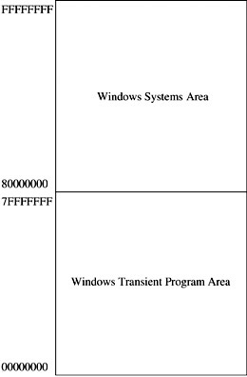
Figure 1–10 The memory map used by Windows XP.
TPA is first 2G bytes from locations 00000000H to 7FFFFFFFH.
Every Windows program can use up to 2G bytes of memory located at linear addresses 00000000H through 7FFFFFFFH.
System area is last 2G bytes from 80000000H
to FFFFFFFFH.

Slide 123
Memory system physical map is much different.
Every process in a Windows Vista, XP, or 2000 system has its own set of page tables.
The process can be located anywhere in the memory, even in noncontiguous pages.
The operating system assigns physical memory to application.
  if not enough exists, it uses the hard disk
  for any that is not available

Slide 124
I/O Space
I/O devices allow the microprocessor to communicate with the outside world.
I/O (input/output) space in a computer system extends from I/O port 0000H to port FFFFH.
  I/O port address is similar to a memory address
  instead of memory, it addresses an I/O device
Figure 1–11 shows the I/O map found in many personal computer systems.

Slide 125
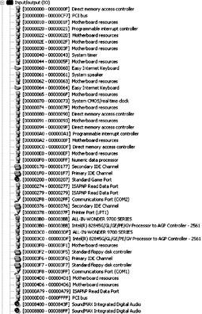
Figure 1–11 Some I/O locations in a typical personal computer.
Access to most I/O devices should always be made through Windows, DOS, or BIOS function calls.
The map shown is provided as a guide to illustrate the I/O space in the system.

Slide 126
The area below I/O location 0400H is considered reserved for system devices
Area available for expansion extends from I/O port 0400H through FFFFH.
Generally, 0000H - 00FFH addresses main board components; 0100H - 03FFH handles devices located on plug-in cards or also on the main board.
The limitation of I/O addresses between 0000 and 03FFH comes from original standards specified by IBM for the PC standard.

Slide 127
The Microprocessor
Called the CPU (central processing unit).
The controlling element in a computer system.
Controls memory and I/O through connections called buses.
  buses select an I/O or memory device, transfer data between I/O devices or memory and the microprocessor, control I/O and memory systems
Memory and I/O controlled via instructions stored in memory, executed by the microprocessor.

Slide 128
Microprocessor performs three main tasks:
  data transfer between itself and the memory or I/O systems
  simple arithmetic and logic operations
  program flow via simple decisions
Power of the microprocessor is capability to execute billions of millions of instructions per second from a program or software (group of instructions) stored in the memory system.
  stored programs make the microprocessor and computer system very powerful devices

Slide 129
Another powerful feature is the ability to make simple decisions based upon numerical facts.
  a microprocessor can decide if a number is zero, positive, and so forth
These decisions allow the microprocessor to modify the program flow, so programs appear to think through these simple decisions.

Slide 130
Buses
A common group of wires that interconnect components in a computer system.
Transfer address, data, & control information between microprocessor, memory and I/O.
Three buses exist for this transfer of information: address, data, and control.
Figure 1–12 shows how these buses interconnect various system components.

Slide 131
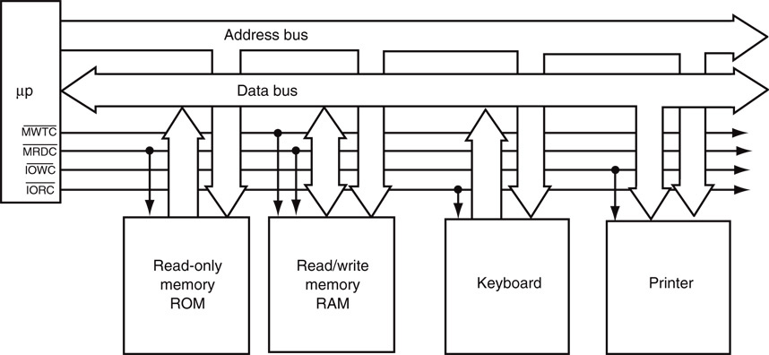
Figure 1–12 The block diagram of a computer system showing the address, data, and control bus structure.

Slide 132
The address bus requests a memory location from the memory or an I/O location from the I/O devices.
  if I/O is addressed, the address bus contains a 16-bit I/O address from 0000H through FFFFH.
  if memory is addressed, the bus contains a memory address, varying in width by type of
  microprocessor.
64-bit extensions to Pentium provide 40 address pins, allowing up to 1T byte of memory to be accessed.

Slide 133
The data bus transfers information between the microprocessor and its memory and I/O address space.
Data transfers vary in size, from 8 bits wide to 64 bits wide in various Intel microprocessors.
  8088 has an 8-bit data bus that transfers 8 bits
  of data at a time
  8086, 80286, 80386SL, 80386SX, and 80386EX transfer 16 bits of data
  80386DX, 80486SX, and 80486DX, 32 bits
  Pentium through Core2 microprocessors transfer 64 bits of data

Slide 134
Advantage of a wider data bus is speed in applications using wide data.
Figure 1–13 shows memory widths and sizes of 8086 through Core2 microprocessors.
In all Intel microprocessors family members, memory is numbered by byte.
Pentium through Core2 microprocessors contain a 64-bit-wide data bus.

Slide 135
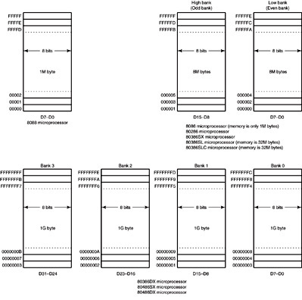
Figure 1–13a The physical memory systems of the 8086 through the Core2 microprocessors.

Slide 136
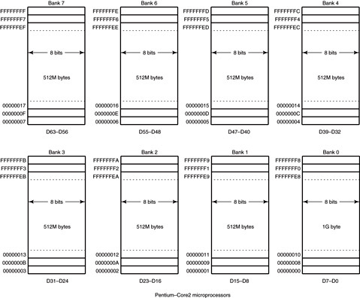
Figure 1–13b The physical memory systems of the 8086 through the Core2 microprocessors.

Slide 137
Control bus lines select and cause memory or I/O to perform a read or write operation.
In most computer systems, there are four control bus connections:
MRDC (memory read control)
MWTC (memory write control)
IORC (I/O read control)
IOWC (I/O write control).
overbar indicates the control signal is active-low; (active when logic zero appears on control line)

Slide 138
The microprocessor reads a memory location by sending the memory an address through the address bus.
Next, it sends a memory read control signal to cause the memory to read data.
Data read from memory are passed to the microprocessor through the data bus.
Whenever a memory write, I/O write, or I/O read occurs, the same sequence ensues.

Slide 139
1–3 NUMBER SYSTEMS
Use of a microprocessor requires working knowledge of numbering systems.
  binary, decimal, and hexadecimal
This section provides a background for these numbering systems.
Conversions are described.
  decimal and binary
  decimal and hexadecimal
  binary and hexadecimal

Slide 140
Digits
Before converting numbers between bases, digits of a number system must be understood.
First digit in any numbering system is always zero.
A decimal (base 10) number is constructed with 10 digits: 0 through 9.
A base 8 (octal) number; 8 digits: 0 through 7.
A base 2 (binary) number; 2 digits: 0 and 1.

Slide 141
If the base exceeds 10, additional digits use letters of the alphabet, beginning with an A.
  a base 12 number contains 10 digits: 0 through 9, followed by A for 10 and B for 11
Note that a base 10 number does contain a 10 digit.
  a base 8 number does not contain an 8 digit
Common systems used with computers are decimal, binary, and hexadecimal (base 16).
  many years ago octal numbers were popular

Slide 142
Positional Notation
Once digits are understood, larger numbers are constructed using positional notation.
  position to the left of the units position is the tens position
  left of tens is the hundreds position, and so forth
An example is decimal number 132.
  this number has 1 hundred, 3 tens, and 2 units
Exponential powers of positions are critical for understanding numbers in other systems.

Slide 143
Exponential value of each position:
  the units position has a weight of 10⁰, or 1
  tens position a weight of 10¹, or 10
  hundreds position has a weight of 10², or 100
Position to the left of the radix (number base) point is always the units position in system.
  called a decimal point only in the decimal system
  position to left of the binary point always 2⁰, or 1
  position left of the octal point is 8⁰, or 1
Any number raised to its zero power is always one (1), or the units position.

Slide 144
Position to the left of the units position always the number base raised to the first power.
  in a decimal system, this is 10¹, or 10
  binary system, it is 2¹, or 2
  11 decimal has a different value from 11 binary
11 decimal has different value from 11 binary.
  decimal number composed of 1 ten, plus 1 unit;
  a value of 11 units
  binary number 11 is composed of 1 two, plus 1 unit: a value of 3 decimal units
  11 octal has a value of 9 decimal units

Slide 145
In the decimal system, positions right of the decimal point have negative powers.
  first digit to the right of the decimal point has a value of 10⁻¹, or 0.1.
In the binary system, the first digit to the right of the binary point has a value of 2⁻¹, or 0.5.
Principles applying to decimal numbers also generally apply to those in any other system.
To convert a binary number to decimal, add weights of each digit to form its decimal equivalent.

Slide 146
Conversion from Decimal
To convert from any number base to decimal, determine the weights or values of each position of the number.
Sum the weights to form the decimal equivalent.

Slide 147
Conversion to Decimal
Conversions from decimal to other number systems more difficult to accomplish.
To convert the whole number portion of a number to decimal, divide by 1 radix.
To convert the fractional portion, multiply by the radix.

Slide 148
Whole Number Conversion from Decimal
To convert a decimal whole number to another number system, divide by the radix and save remainders as significant digits of the result.
An algorithm for this conversion:
  divide the decimal number by the radix
  (number base)
  save the remainder
  (first remainder is the least significant digit)
  repeat steps 1 and 2 until the quotient is zero

Slide 149
To convert 10 decimal to binary, divide it by 2.
  the result is 5, with a remainder of 0
First remainder is units position of the result.
  in this example, a 0
Next, divide the 5 by 2; result is 2, with a remainder of 1.
  the 1 is the value of the twos (2¹) position
Continue division until the quotient is a zero.
The result is written as 1010₂ from the bottom to the top.

Slide 150
To convert 10 decimal to base 8, divide by 8.
  a 10 decimal is a 12 octal.
For decimal to hexadecimal, divide by 16.
  remainders will range in value from 0 through 15
  any remainder of 10 through 15 is converted to letters A through F for the hexadecimal number
  decimal number 109 converts to a 6DH

Slide 151
Converting from a Decimal Fraction
Conversion is accomplished with multiplication by the radix.
Whole number portion of result is saved as a significant digit of the result.
  fractional remainder again multiplied by the radix
  when the fraction remainder is zero, multiplication ends
Some numbers are never-ending (repetend).
  a zero is never a remainder

Slide 152
Algorithm for conversion from a decimal fraction:
  multiply the decimal fraction by the radix
  (number base).
  save the whole number portion of the result
  (even if zero) as a digit; first result is written immediately to the right of the radix point
  repeat steps 1 and 2, using the fractional part of step 2 until the fractional part of step 2 is zero
Same technique converts a decimal fraction into any number base.

Slide 153
Binary-Coded Hexadecimal
Binary-coded hexadecimal (BCH) is a hexadecimal number written each digit is represented by a 4-bit binary number.
BCH code allows a binary version of a hexadecimal number to be written in a form easily converted between BCH and hexadecimal.
Hexadecimal represented by converting digits to BCH code with a space between each digit.

Slide 154
Complements
At times, data are stored in complement form to represent negative numbers.
Two systems used to represent negative data:
  radix
  radix − 1 complement (earliest)

Slide 155
1–4 COMPUTER DATA FORMATS
Successful programming requires a precise understanding of data formats.
Commonly, data appear as ASCII, Unicode, BCD, signed and unsigned integers, and floating-point numbers (real numbers).
Other forms are available but are not commonly found.

Slide 156
ASCII and Unicode Data
ASCII (American Standard Code for Information Interchange) data represent alphanumeric characters in computer memory.
Standard ASCII code is a 7-bit code.
  eighth and most significant bit used to hold parity
If used with a printer, most significant bits are 0 for alphanumeric printing; 1 for graphics.
In PC, an extended ASCII character set is selected by placing 1 in the leftmost bit.

Slide 157
Extended ASCII characters store:
  some foreign letters and punctuation
  Greek & mathematical characters
  box-drawing & other special characters
Extended characters can vary from one printer to another.
ASCII control characters perform control functions in a computer system.
  clear screen, backspace, line feed, etc.
Enter control codes through the keyboard.
  hold the Control key while typing a letter

Slide 158
Many Windows-based applications use the Unicode system to store alphanumeric data.
  stores each character as 16-bit data
Codes 0000H–00FFH are the same as standard ASCII code.
Remaining codes, 0100H–FFFFH, store all special characters from many character sets.
Allows software for Windows to be used in many countries around the world.
For complete information on Unicode, visit: http://www.unicode.org

Slide 159
BCD (Binary-Coded Decimal) Data
The range of a BCD digit extends from 0000₂ to 1001₂, or 0–9 decimal, stored in two forms:
Stored in packed form:
  packed BCD data stored as two digits per byte;
  used for BCD addition and subtraction in the instruction set of the microprocessor
Stored in unpacked form:
  unpacked BCD data stored as one digit per byte
  returned from a keypad or keyboard

Slide 160
Applications requiring BCD data are point-of-sales terminals.
  also devices that perform a minimal amount of simple arithmetic
If a system requires complex arithmetic, BCD data are seldom used.
  there is no simple and efficient method of performing complex BCD arithmetic

Slide 161
Byte-Sized Data
Stored as unsigned and signed integers.
Difference in these forms is the weight of the leftmost bit position.
  value 128 for the unsigned integer
  minus 128 for the signed integer
In signed integer format, the leftmost bit represents the sign bit of the number.
  also a weight of minus 128

Slide 162
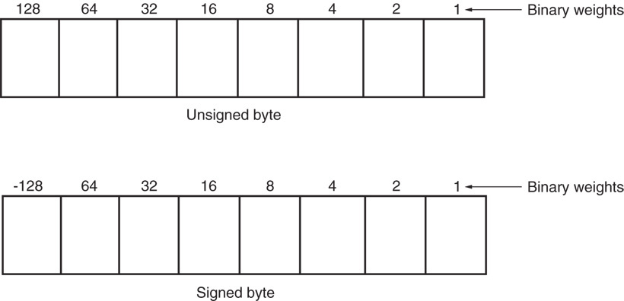
Figure 1–14 The unsigned and signed bytes illustrating the weights of each binary-bit position.

Slide 163
Unsigned integers range 00H to FFH (0–255)
Signed integers from −128 to 0 to + 127.
Negative signed numbers represented in this way are stored in the two’s complement form.
Evaluating a signed number by using weights of each bit position is much easier than the act of two’s complementing a number to find its value.
  especially true in the world of calculators designed for programmers

Slide 164
Word-Sized Data
A word (16-bits) is formed with two bytes of data.
The least significant byte always stored in the lowest-numbered memory location.
Most significant byte is stored in the highest.
This method of storing a number is called the little endian format.

Slide 165
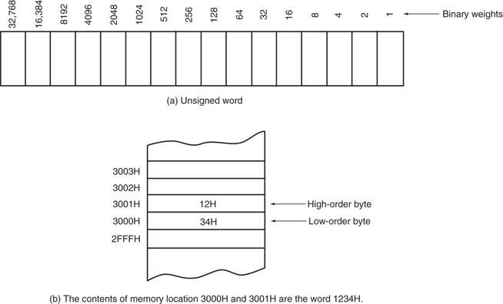
Figure 1–15 The storage format for a 16-bit word in (a) a register and (b) two bytes of memory.

Slide 166
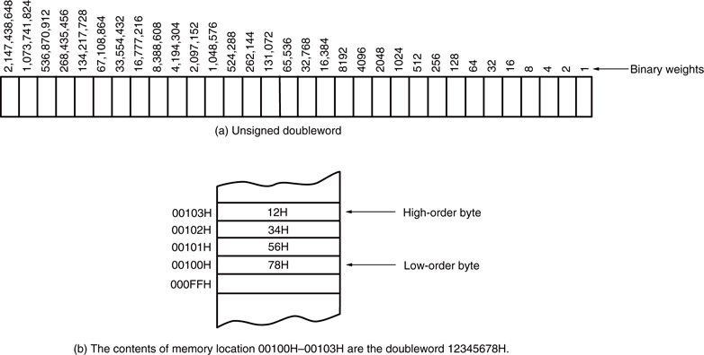
Figure 1–16 The storage format for a 32-bit word in (a) a register and (b) 4 bytes of memory.

Slide 167
Alternate method is called the big endian format.
Numbers are stored with the lowest location containing the most significant data.
Not used with Intel microprocessors.
The big endian format is used with the Motorola family of microprocessors.

Slide 168
Doubleword-Sized Data
Doubleword-sized data requires four bytes
of memory because it is a 32-bit number.
  appears as a product after a multiplication
  also as a dividend before a division
Define using the assembler directive define doubleword(s), or DD.
  also use the DWORD directive in place of DD

Slide 169
Real Numbers
Since many high-level languages use Intel microprocessors, real numbers are often encountered.
A real, or a floating-point number contains two parts:
  a mantissa, significand, or fraction
  an exponent.
A 4-byte number is called single-precision.
The 8-byte form is called double-precision.

Slide 170
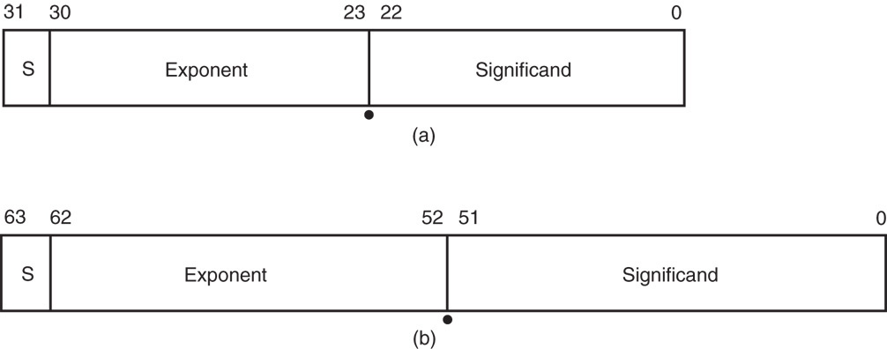
Figure 1–17 The floating-point numbers in (a) single-precision using a bias of 7FH and (b) double-precision using a bias of 3FFH.

Slide 171
The assembler can be used to define real numbers in single- & double-precision forms:
  use the DD directive for single-precision 32-bit numbers
  use define quadword(s), or DQ to define 64-bit double-precision real numbers
Optional directives are REAL4, REAL8, and REAL10.
  for defining single-, double-, and extended precision real numbers

Slide 172
SUMMARY
Mechanical computer age began with the advent of the abacus in 500 B.C.
This first mechanical calculator remained unchanged until 1642, when Blaise Pascal improved it.
An early mechanical computer system was the Analytical Engine developed by Charles Babbage in 1823.

Slide 173
SUMMARY
(cont.)
The first electronic calculating machine was developed during World War II by Konrad Zuse, an early pioneer of digital electronics.
The Z3 was used in aircraft and missile design for the German war effort.
The first electronic computer, which used vacuum tubes, was placed into operation in 1943 to break secret German military codes.

Slide 174
SUMMARY
(cont.)
The first electronic computer system, the Colossus, was invented by Alan Turing.
Its only problem was that the program was fixed and could not be changed.
The first general-purpose, programmable electronic computer system was developed in 1946 at the University of Pennsylvania.
This first modern computer was called the ENIAC (Electronics Numerical Integrator and Calculator).

Slide 175
SUMMARY
(cont.)
The first high-level programming language, called FLOWMATIC.
Developed for the UNIVAC I computer by Grace Hopper in the early 1950s.
This led to FORTRAN and other early programming languages such as COBOL.

Slide 176
SUMMARY
(cont.)
The world's first microprocessor, the Intel 4004, was a 4-bit microprocessor-a programmable controller on a chip-that was meager by today's standards.
It addressed a mere 4096 4-bit memory locations.
Its instruction set contained only 45 different instructions.

Slide 177
SUMMARY
(cont.)
Microprocessors that are common today include the 8086/8088, which were the first 16-bit microprocessors.
Following these early 16-bit machines were the 80286, 80386, 80486, Pentium, Pentium Pro, Pentium II, Pentium III, Pentium 4, and Core2 processors.
The architecture has changed from 16 bits to 32 bits and, with the Itanium, to 64 bits.

Slide 178
SUMMARY
(cont.)
With each newer version, improvements followed that increased the processor's speed and performance.
From all indications, this process of speed and performance improvement will continue.
Performance increases may not always come from an increased clock frequency.

Slide 179
SUMMARY
(cont.)
DOS-based personal computers contain memory systems that include three main areas: TPA (transient program area), system area, and extended memory.
The TPA hold: application programs, the operating system, and drivers.
The system area contains memory used for video display cards, disk drives, and the BIOS ROM.

Slide 180
SUMMARY
(cont.)
The extended memory area is only available to the 80286 through the Core2 microprocessor in an AT-style or ATX-style personal computer system.
The Windows-based personal computers contain memory systems that include two main areas: TPA and systems area.

Slide 181
SUMMARY
(cont.)
The 8086/8088 address 1M byte of memory from locations 00000H-FFFFFH.
The 80286 and 80386SX address 16M bytes of memory from 000000H-FFFFFFH.
The 80386SL addresses 32M bytes of memory from 0000000H-1FFFFFFH.
The 80386DX through the Core2 address 4G bytes of memory from locations 00000000H-FFFFFFFFH.

Slide 182
SUMMARY
(cont.)
Pentium Pro through the Core2 can operate with a 36-bit address and access up to 64G bytes of memory from locations 000000000H-FFFFFFFFFH.
A Pentium 4 or Core2 operating with 64-bit extensions addresses memory from locations 0000000000H- FFFFFFFFFFH for 1T byte of memory.

Slide 183
SUMMARY
(cont.)
All versions of the 8086 through the Core2 microprocessors address 64K bytes of I/O address space.
These I/O ports are numbered from 0000H to FFFFH with I/O ports 0000H-03FFH reserved for use by the personal computer system.
The PCI bus allows ports 0400H-FFFFH.

Slide 184
SUMMARY
(cont.)
The operating system in early personal computers was either MSDOS (Microsoft disk operating system) or PCDOS (personal computer disk operating system from IBM).
The operating system performs the task of operating or controlling the computer system, along with its I/O devices.
Modern computers use Microsoft Windows in place of DOS as an operating system.

Slide 185
SUMMARY
(cont.)
The microprocessor is the controlling element in a computer system.
The micro-processor performs data transfers, does simple arithmetic and logic operations, and makes simple decisions.
The microprocessor executes programs stored in the memory system to perform complex operations in short periods of time.

Slide 186
SUMMARY
(cont.)
All computer systems contain three buses to control memory and I/O.
The address bus is used to request a memory location or I/O device.
The data bus transfers data between the microprocessor and its memory and I/O spaces.
The control bus controls the memory and I/O, and requests reading or writing of data.

Slide 187
SUMMARY
(cont.)
Numbers are converted from any number base to decimal by noting the weights of each position.
The weight of the position to the left of the radix point is always the units position in any number system.
The position to the left of the units position is always the radix times one.
Succeeding positions are determined by multiplying by the radix.

Slide 188
SUMMARY
(cont.)
The weight of the position to the right of the radix point is always deter-mined by dividing by the radix.
Conversion from a whole decimal number to any other base is accomplished by di-viding by the radix.
Conversion from a fractional decimal number is accomplished by multiplying by the radix.

Slide 189
SUMMARY
(cont.)
Hexadecimal data are represented in hexadecimal form or in a code called binary-coded hexadecimal (BCH).
A binary-coded hexadecimal number is one that is written with a 4-bit binary number that represents each hexadecimal digit.
The ASCII code is used to store alphabetic or numeric data.

Slide 190
SUMMARY
(cont.)
The ASCII code is a 7-bit code; it can have an eighth bit that is used to extend the character set from 128 codes to 256 codes.
The carriage return (Enter) code returns the print head or cursor to the left margin.
The line feed code moves the cursor or print head down one line.
Most modern applications use Unicode, which contains ASCII at codes 0000H-00FFH.

Slide 191
SUMMARY
(cont.)
Binary-coded decimal (BCD) data are sometimes used in a computer system to store decimal data.
These data are stored either in packed (two digits per byte) or unpacked (one digit per byte) form.
Binary data are stored as a byte (8 bits), word (16 bits), or doubleword (32 bits) in a computer system.
These data may be unsigned or signed.

Slide 192
SUMMARY
(cont.)
Signed negative data are always stored in the two's complement form.
Data that are wider than 8 bits are always stored using the little endian format.
In 32-bit Visual C++ these data are represented with char (8 bits), short (16 bits) and int (32 bits).

Slide 193
SUMMARY
Floating-point data are used in computer systems to store whole, mixed, and frac-tional numbers.
A floating-point number is composed of a sign, a mantissa, and an exponent.
The assembler directives DB or BYTE define bytes, DW or WORD define words, DD or DWORD define doublewords, and DQ or QWORD define quadwords.

